Slide 1


PDaSP: Track 2: A Holistic Privacy Preserving Collaborative Data Sharing System for Intelligent Transportation
Yuan Hong and Song Han (University of Connecticut)
Jeff Ban and Angela Kitali (University of Washington)
Binghui Wang (Illinois Institute of Technology)
Meisam Mohammady (Iowa State University)
NSF PDaSP Virtual Kick-off Meeting
12/04/2025

Slide 2
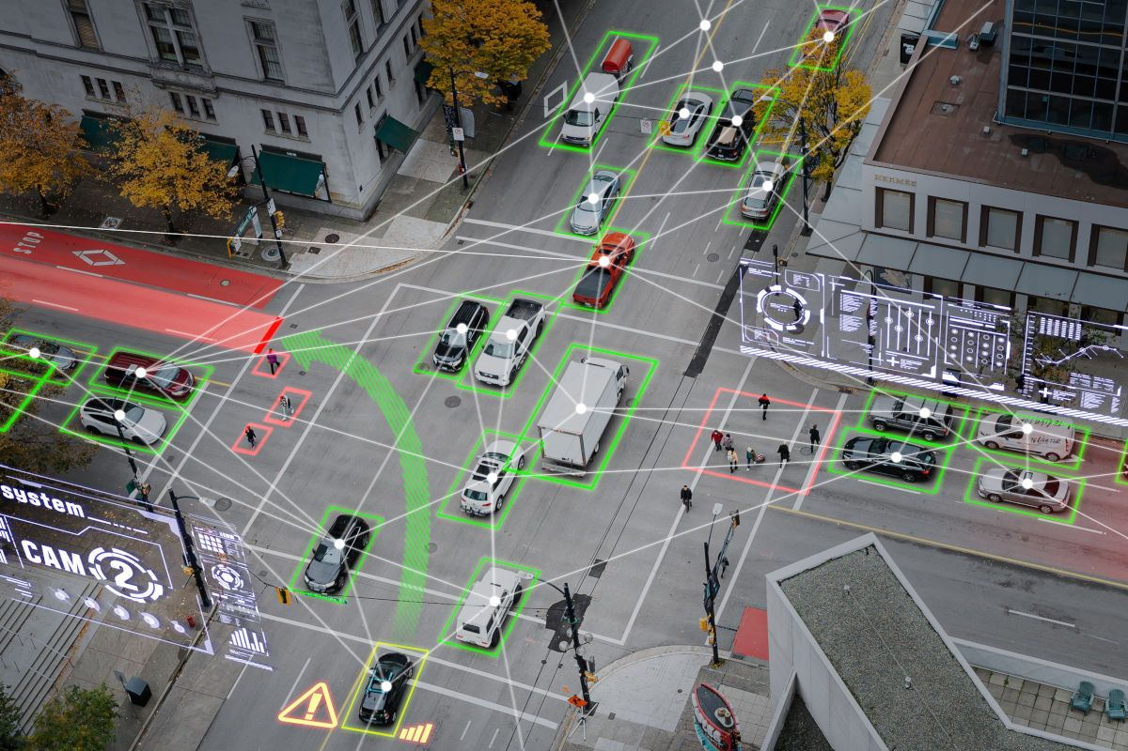
Data in Transportation Systems
Transportation Data: vehicle/user data, infrastructure data, V2X (vehicle-to-everything) data
Transportation data supports diverse applications:
Traffic flow and travel behavior, traffic state estimation, traffic control and operations, traffic safety and human factor, multimodal mobility systems, planning and travel demand management
Naturalistic Driving Data (NDD): real-world driving information collected from drivers as they go about their normal daily activities
Cameras (e.g., road-facing, driver-facing, cabin)
Accelerometers
CAN-bus data (e.g., speed, brake use, steering angle)
Radar/LiDAR
Environmental sensors (e.g., weather, traffic density)
Can be used for understanding crash causes, modeling driver behavior and attention, testing
and training autonomous-vehicle algorithms, evaluating advanced driver-assistance systems
(ADAS), transportation safety policy and infrastructure planning, etc.
Image source: https://www.swarco.com/mobility-future/intelligent-transportation-systems

Slide 3
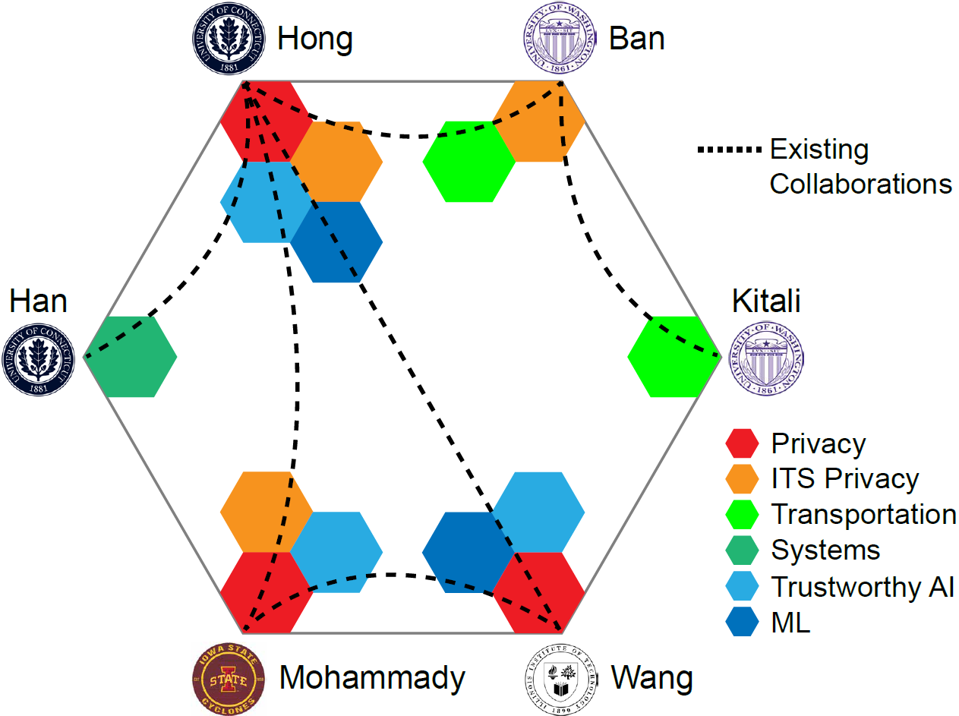
Our Team
Privacy: Yuan Hong, Binghui Wang, Meisam Mohammady
Differential privacy (DP), applied cryptography, machine learning privacy (attacks and defenses), machine unlearning, usable privacy, etc.
Publications: S&P, CCS, USENIX Security, NDSS, NeurIPS, ICLR, SIGMOD, VLDB, ICML, CVPR, ECCV, PETS, CSF, EMNLP, etc.
Transportation: Jeff Ban, Angela Kitali
Traffic flow and travel behavior, traffic state estimation, traffic control and operations, traffic safety and human factor, multimodal mobility systems, planning and travel demand management, etc.
Publications: TR-A, TR-B, TR-C, T-ITS, AAAI, etc.
Transportation Privacy: Yuan Hong, Jeff Ban, Meisam Mohammady
Location and trajectory privacy, V2X privacy, mobile sensing privacy, private traffic monitoring
Publications: CCS, MobiSys, TR-B, T-ITS, TDSC, T-IFS, etc.
Systems: Song Han
Cyber-physical systems, real-time systems, V2X communications
Publications: RTSS, RTAS, DAC, etc.

Slide 4
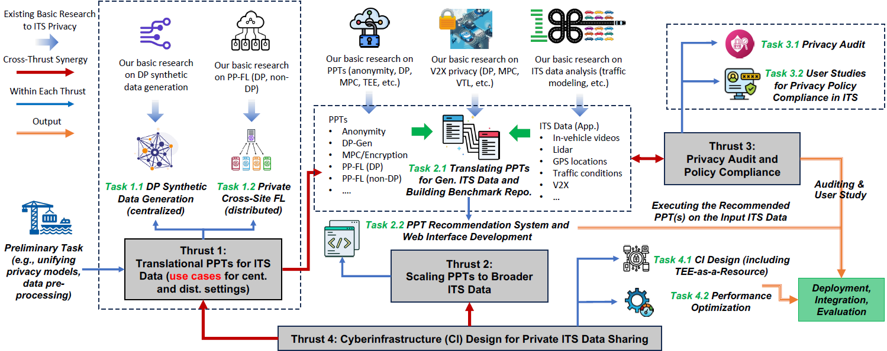
Project Overview: PrivAcy PreservIng ShaRing Platform (PAIR)
The PAIR Platform
(PPT: Privacy-Preserving Technique)

Slide 5
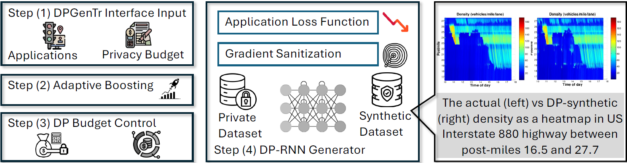
Thrust 1: Differentially Private Data Synthesis (Centralized) – Task 1.1
Synthetic Recurrent Neural Net (RNN) Vehicle Trajectories Generator DeapSneak [TIST’24]
DP-synthetic traffic flow retaining key spatial–temporal patterns Naturalistic DP I-880 [VehicleSec’23]
Task-optimal DP mechanism design PLRV-O [CCS’25]
Lap₂ [CSF’26]
R²DP [CCS’20]
Bounding DP budget in infinite streams DPI [S&P’24]
Notes:
Real-world driving data contains highly sensitive location and behavioral information
Resource-efficient generating synthetic Naturalistic trajectories is essential (DP-protected!)
Challenges are:
Utility Loss Under DP: 1) DP noise distorts rare events (hazardous events?!)
2) DP-SGD (standard tool for AI Privacy) is slow due to (suboptimal?!)
noise, clipping, and accounting (cheap generation is essential!)
Streaming / Incremental Deployment: ITS data arrives continuously; we must
1) Retain quality, diversity, and practical usability of generated outputs, e.g., Diffusion
generated trajectories with high Fréchet Inception Distance (FID) metric
2) Formulate and Bound long-term privacy leakage
We propose DPGenTr. Modules to build and harmonize:
Interface Input: Load application, privacy budget, resources (memory, GPU,..)
Adaptive Mechanism Design: Bounding DP Budget in Infinite streams, Adaptive Boosting, Optimal DP-SGD gradient sanitization (clip, noise, model choice, ..)

Slide 6
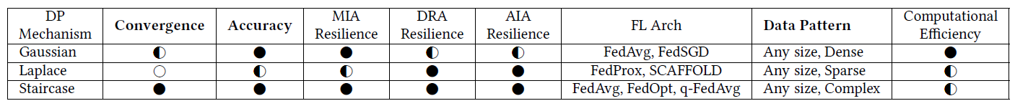
Task 1.2: Privacy Preserving Federated Learning (Distributed)
Distributed setting: multiple sites collaboratively train a PP-FL model
E.g., multiple agencies collaboratively train a driving behavior prediction model using their “naturalistic” in-vehicle videos (raw videos cannot be shared)
Challenges when adapting existing PP-FL to ITS applications
Temporally-correlated data (e.g., trajectories, in-vehicle videos)
Existing PP-FL focuses on independent data (e.g., images), while ITS data is temporally dependent
Adjacent timestamps are highly correlated
Direct learning is computationally expensive due to high-dimensional features
General-purpose tasks (task-agnostic)
ITS data supports various applications, e.g., crash mitigation, driving behavior analysis, traffic prediction
Potential Solutions: (1) information theory-based, (2) DP-based PP-FL
Information-theoretic PP-FL for task-agnostic ITS [USENIX Security’24a, AAAI’25]
Differentially-private FL for task-agnostic ITS applications [CCS’22, CODASPY’25]
Notes:
Extend Inf2Guard [1] to cross-site FL for temporal ITS data
Learn site-specific privacy-preserving encoders to avoid server-side data leakage
Achieves strong utility–privacy tradeoff with formal guarantees
Handling Temporal Dependency
Apply Markov assumption: future depends only on current state
Convert high-dimensional temporal data into lower-dimensional representations
Significantly lowers computational cost
Task-Agnostic Design
Encoder trained on raw data only (no labels)
Maximize retained information in representations
Ensure downstream models achieve comparable performance → preserves utility

Slide 7
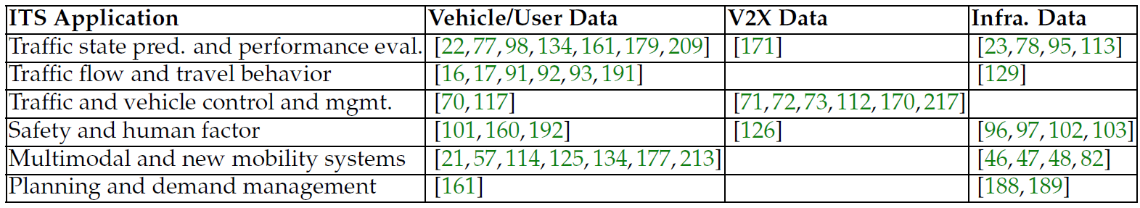
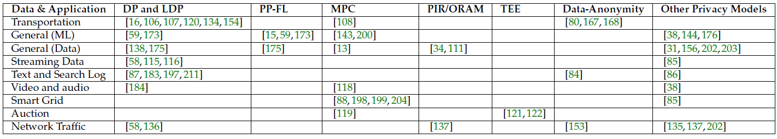
Thrust 2: Generalized PPT Platform and Benchmarks
Research team has collectively worked on almost every ITS application supported by different types of ITS data, and almost every type of PPTs

Slide 8
Task 2.1: Benchmark Repository for “PPTs + ITS Data/Applications”
Top-3 PPTs for a set of widely-used ITS applications support by ITS Data
Evaluation metrics:
User-level privacy (U-P): privacy guarantee for each user
Site-level privacy (S-P): privacy guarantee for a data sharing site
Data utility (U): analysis accuracy of ITS applications
Efficiency (E): computation/communication overheads
Challenges & Solutions
 | Challenge | Solution
I | PPTs can be task-specific (may not be adaptable) | Feasibility study
II | New (unknown) ITS data & applications | Develop a PPT recommendation system
III | Privacy risks in practice | Privacy audits & compliance evaluation (Thrust 3)
Notes:
PPTs can be task-specific, may not work for each ITS application/data

Slide 9
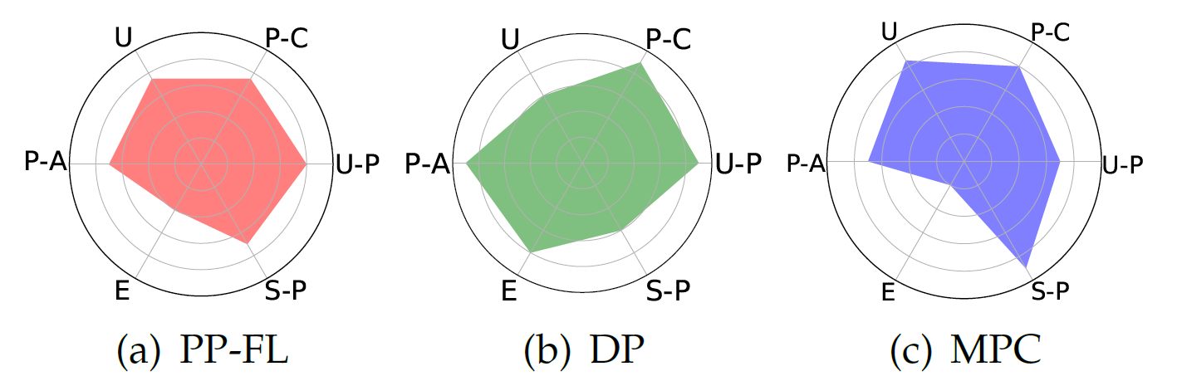
Task 2.2: PPT Recommendation System
Goal: work with data-sharing sites to recommend PPTs tailored to their needs:
VTTI SHRP2 Data on Naturalistic driving
Seattle Department of Transportation (SDoT)
Cuebiq
USDOT funded university transportation centers (UTC): PacTrans, C2Smarter*
PPT Recommendation
Weighted-sum of site preferences
Pareto optimization for tradeoffs
User-level privacy (U-P), site-level privacy (S-P), utility (U), privacy auditability (P-A), privacy policy compliance (P-C), efficiency (E)

Slide 10
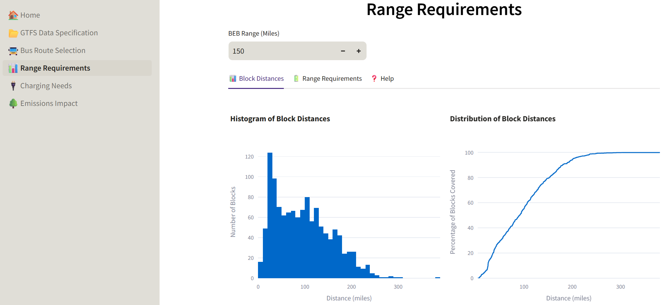
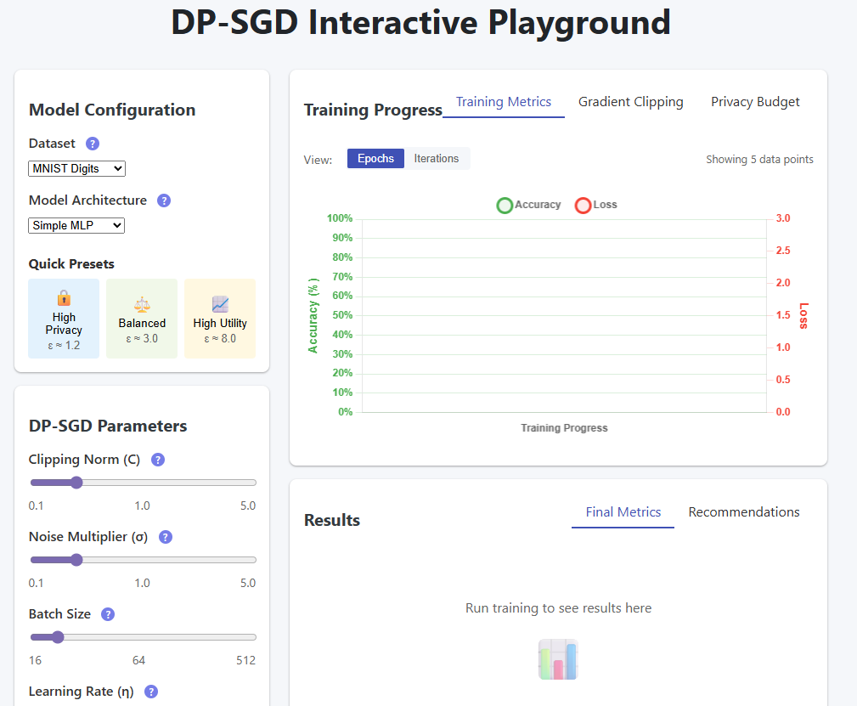
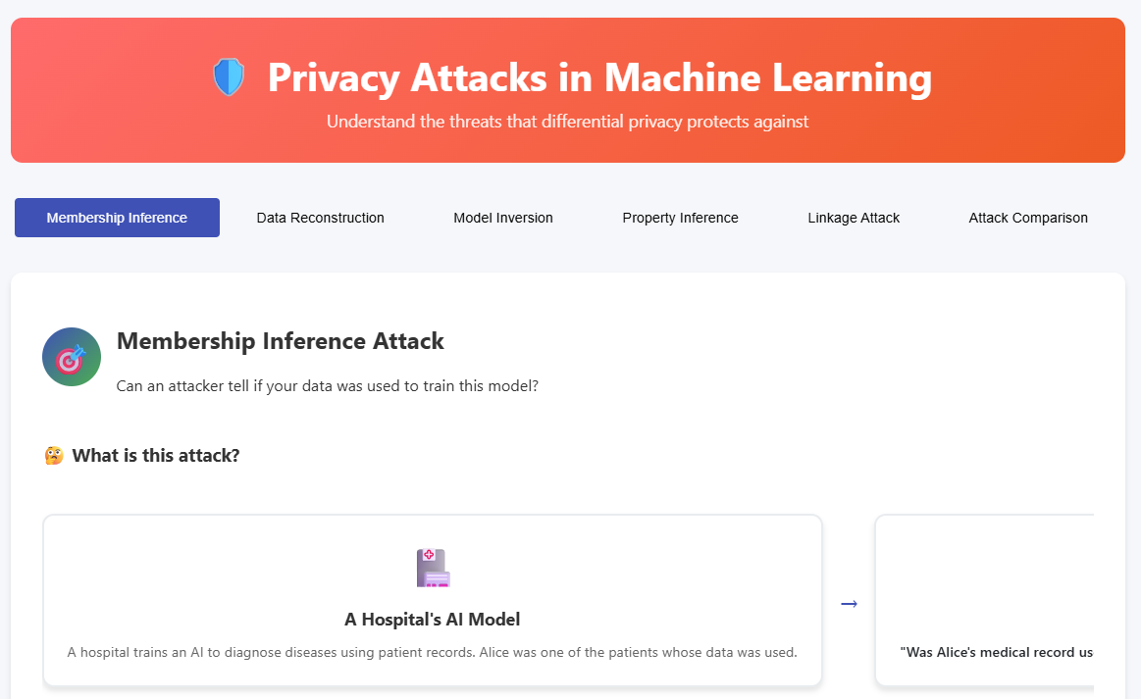
Task 2.3: Web Interface
Web-based platform to help data-sharing sites address their PPT needs
Allow other potential data-sharing sites to explore possible PPT solutions specific to their needs, encouraging wider ITS data sharing
Key components:
Front-end: layout, navigation, forms
Back-end: APIs, database, algorithms
Security mechanisms: authentication and encryption
User feedback: error message, notification, etc.
Past experience and current progress:
Dashboard for ZEBRA (Zero-Emission Bus Range & Recharging Assessment)
Dashboard for visualizing DP-SGD and privacy attacks in machine learning

Slide 11
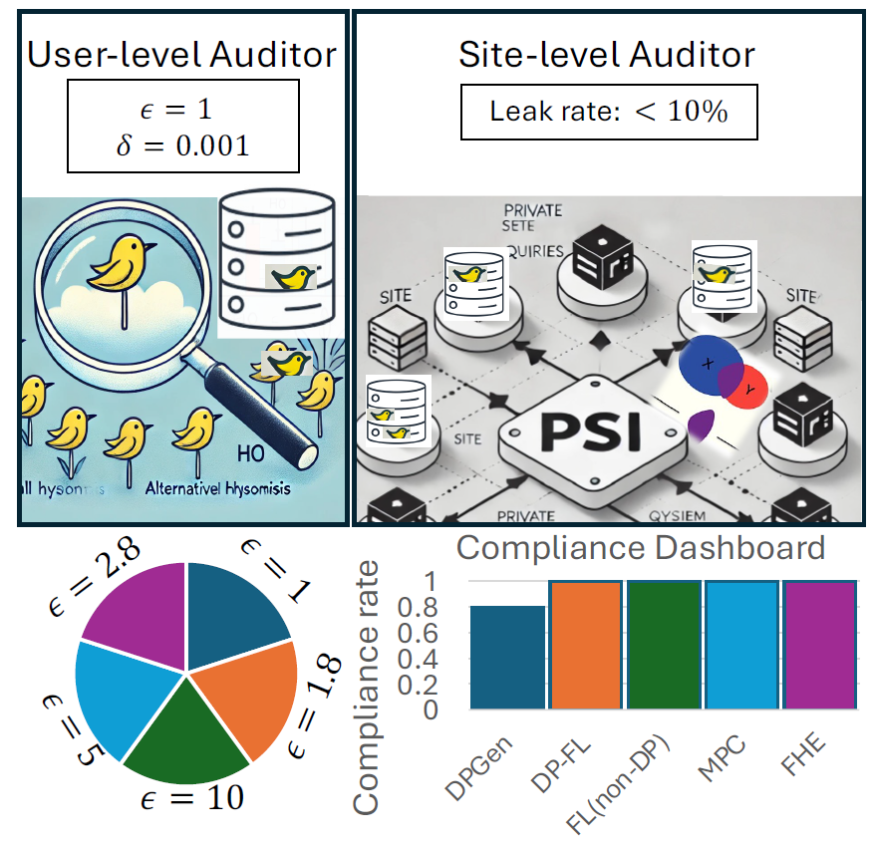

Thrust 3: Privacy Auditing and Policy Compliance
Task 3.1: monitoring privacy with auditor tools in ITS – translating privacy guarantees to practical risks [USENIX Security’25]
User-level audit: canary injection for DP auditing
Site-level audit: private set intersection (PSI) for leakage auditing
PP-FL (both DP and non-DP) and anonymization can be audited
by adapting inference attacks.
Task 3.2: user studies (after IRB approval) for privacy policy
compliance in ITS, e.g., GDPR, CCPA, ISO/IEC 27701,
NIST privacy [USENIX Security’24b]
Data retention policy compliance
PPT recommenation assessment
Users’ privacy preferences and policy compliance
Privacy auditing and compliance
Image source: https://blog.codelitt.com/different-user-research-methods-pros-cons-and-tips-for-using-them/

Slide 12
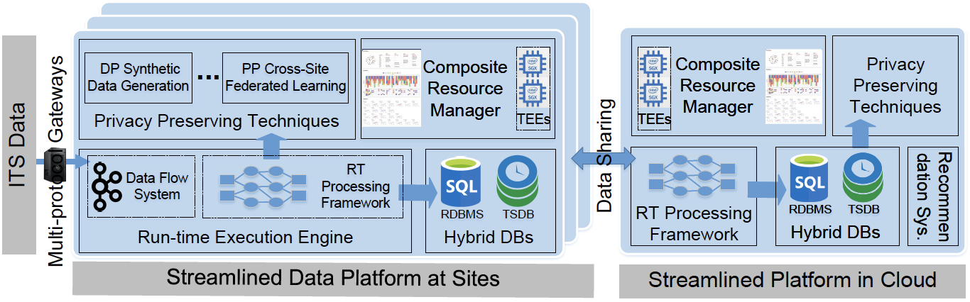
Thrust 4: Cyberinfrastructure Design
Goal: design a streamlined cyberinfrastructure (CI) for our PAIR platform to
Support effective data collection, computation, storage, and sharing among agencies
Preserving privacy and ensuring scalable performance
Materialize the translational PPTs proposed in this project
Fully software based, highly scalable according to the available resources
Depending on whether a cloud infrastructure will be included in the design or not, the CI can be cloud-centered or site-centered
Notes:
Relational DB + time sensitive DB

Slide 13
Key Components of the Proposed CI
Hybrid Databases [ICII’18 Best Paper Award]
Scalable Time-Series Database (TSDB) + relational DB
Elastic Real-Time Processing Framework
Apache Kafka for “at least once” delivery guarantee
Apache Spark for real-time and parallel processing
Composite Resource Management Framework [TECS’23, RTSS’19 Outstanding Paper Award]
Enable network and computing resource isolation among data sharing tasks
Provide timing and privacy assurance
TEE-as-a-Resource for Additional Protection
Quantify the privacy requirement and the estimated computational overhead for the ITS data and its processing for different subtasks of the adopted PPT
Assign a “TEE Score” to each PPT by considering an optimal privacy-resource tradeoff
Notes:
In-memory TSDB for improved latency
Design an in-memory TSDB extension to store most recent data to minimize the disk access
Resource-aware computation model for streamlined analysis
Parallelize the computing tasks and map them into computation topologies
Allocate computing resource among multiple computation topologies to meet their resource and privacy requirements
Adaptive resource partition reconfiguration
Develop partition reconfiguration algorithm(s) to adapt the data sharing tasks’ resource partitions in the presence of network/computing dynamics within bounded time

Slide 14
Deployment, Integration and Evaluation
Datasets, testbeds and use cases
Seattle department of transportation (SDOT) – a data provider and early adopter
University transportation centers (UTCs) – an early adopter
Connected vehicles (CV) testbeds – two testbeds will be the data and use-case providers
Naturalistic driving dataset (FHWA) – use cases
Cuebiq mobility dataset – a data and user-case provider
System integration and evaluation
Integrating cyberinfrastructure (CI) into ITS via cloud services
Connecting operational ITS (e.g., CV testbeds) with the CI and stream the collected ITS data in real time
System evaluation: throughput, latency, read/write speeds of the hybrid databases, response time, etc.
End-to-end privacy verification and evaluations
Provable privacy guarantees (e.g., DP, MPC/FHE)
Privacy audits at both user and site levels
User studies for privacy policy compliance
TEE-based additional protection for certain computation
Metrics: utility (e.g., model accuracy, data utility loss), overheads (e.g., throughput, latency, memory consumption), runtime for privacy verification, among others

Slide 15
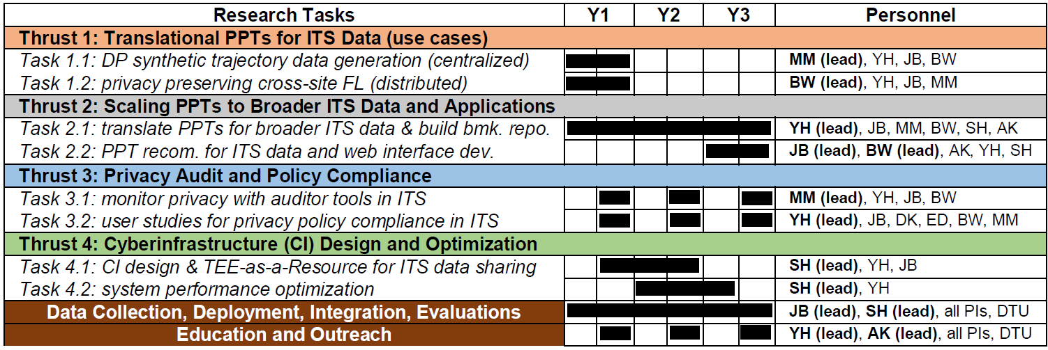
Project Management and Collaboration
Working closely with FHWA and dataset, testbed, and use-case (DTU) providers
All team members meet monthly via Zoom for synchronizing the research progress
Privacy subgroup (YH, BW, MM) will meet with the ITS subgroup (JB, AK) biweekly
Lead PI (YH) will meet with JB (ITS) and SH (systems) to co-design the CI and integrate it with ITS
Privacy subgroup meets with external collaborators on user studies
All teams meet periodically for education and outreach activities
Notes:
DTU: data, testbed, use case providers

Slide 16
Broader Impacts
Data Sharing Impact (PAIR Platform)
Enables privacy-preserving ITS data sharing
Encourage contributions from public agencies, industry, and individuals
Establish a new standard for responsible data sharing in smart cities and science/engineering domains
Societal Impact
Enhanced privacy & trust – protect personal data and travel behaviors
Regulatory compliance – align with GDPR and data protection laws
Public health & safety – improve emergency response and road safety using sanitized data
Scientific Impact
Advance of Privacy-Preserving Techniques (PPTs) – balance utility, privacy, and efficiency
Scalable real-time systems – handle large ITS data without compromising performance
Standardization – develop interoperable PPT protocols for ITS
Interdisciplinary collaboration – connect AI, privacy, cybersecurity, systems, and transportation

Slide 17
Broader Impacts
Education Impact
Benefits graduate students at UConn, UW, IIT, and ISU, and professionals in privacy, transportation, cybersecurity, and AI/ML
Provides undergraduate research opportunities (data collection, analysis, modeling)
Curriculum integration
“Data Security and Privacy” (PI Hong, PI Wang, and PI Mohammady);
“Transportation Networks and Optimization” (PI Ban)
Broader K-12 outreach
UW Discovery Day, IIT STEM Expo, UConn Explore Engineering, ISU Summer Camp
Outreach Impact
Addresses privacy barriers in ITS data sharing (e.g., video data, NYC OpenData context)
Supports adoption of PPTs by agencies and industry
Collaborates with partners to translate basic research into practice
Expected to transform data-sharing and privacy-protection practices in transportation systems

Slide 18
Thank You!
Questions?
Yuan Hong
(on behalf of all the PIs)
Email: yuan.hong@uconn.edu
Webpage: https://yhongcs.github.io/
Acknowledgement of Support

